Slide 7
www.churchadministrators.net/course

Slide 8
‘Bad’ (less effective) communication

Slide 9
‘Bad’ (less effective) communication
Last minute/rushed
Over complicated or too difficult to understand
Details constantly changing
Pitching to the wrong audience
Using exclusive language
Lack of team communication
Not communicating with God

Slide 10
‘Bad’ (less effective) communication
Last minute/rushed
Over complicated or too difficult to understand
Details constantly changing
Pitching to the wrong audience
Using exclusive language
Lack of team communication
Not communicating with God

Slide 11
‘Bad’ (less effective) communication
Last minute/rushed
Over complicated or too difficult to understand
Details constantly changing
Pitching to the wrong audience
Using exclusive language
Lack of team communication
Not communicating with God

Slide 12
‘Bad’ (less effective) communication
Last minute/rushed
Over complicated or too difficult to understand
Details constantly changing
Pitching to the wrong audience
Using exclusive language
Lack of team communication
Not communicating with God

Slide 13
‘Bad’ (less effective) communication
Last minute/rushed
Over complicated or too difficult to understand
Details constantly changing
Pitching to the wrong audience
Using exclusive language
Lack of team communication
Not communicating with God

Slide 14
‘Bad’ (less effective) communication
Last minute/rushed
Over complicated or too difficult to understand
Details constantly changing
Pitching to the wrong audience
Using exclusive language
Lack of team communication
Not communicating with God

Slide 15
‘Bad’ (less effective) communication
Last minute/rushed
Over complicated or too difficult to understand
Details constantly changing
Pitching to the wrong audience
Using exclusive language
Lack of team communication
Not communicating with God

Slide 16
God, I surrender every detail of this week into your loving care
May I know your strength, wisdom and peace so that I may meet any challenges ahead with love and grace
Amen

Slide 17
Solutions:
Communication strategy
Monthly/Yearly/Termly planning
Planning board/spreadsheet
www.churchadministrators.net/resources

Slide 18
Solutions:
Communication strategy
Monthly/Yearly/Termly planning
Planning board/spreadsheet
www.churchadministrators.net/resources

Slide 19
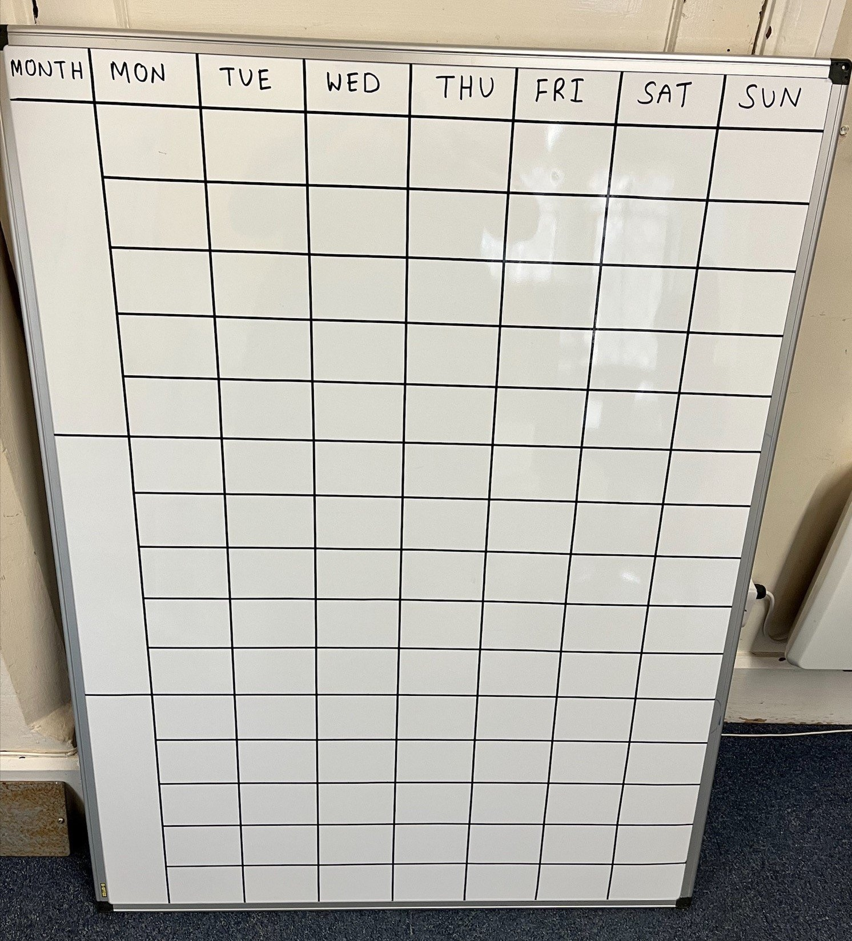
St George & St Paul’s Termly planning board!
An old whiteboard
Some extra thin whiteboard tape from Amazon
A lot of measuring and a bit of patience!

Slide 20
Solutions:
Use what you already have
Whatever you can do, just be consistent
Don’t beat yourself up

Slide 21
Solutions:
Use what you already have
Whatever you can do, just be consistent
Don’t beat yourself up

Slide 22
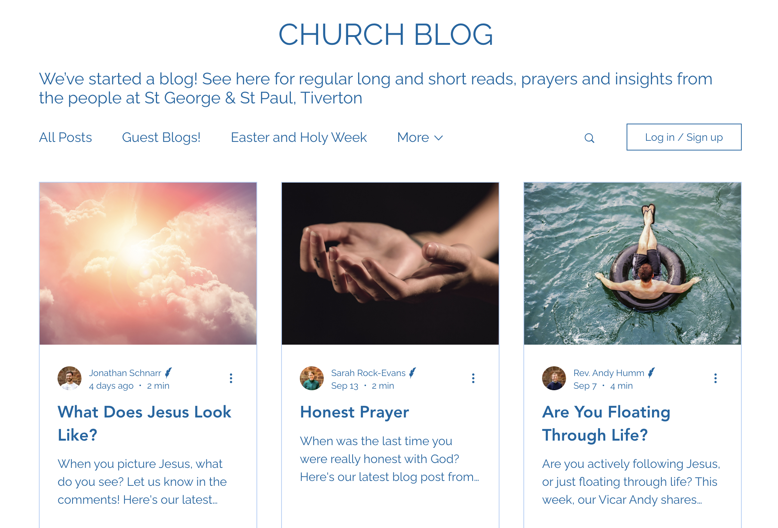
Our newsletter intro became…
A blog post
Good SEO
A way of directing people to our website
Social media content
and…
Reduced the text in our email newsletter
https://www.tivertonchurch.org/blog

Slide 24
Solutions:
Use what you already have
Whatever you can do, just be consistent
Don’t beat yourself up

Slide 25
Solutions:
Learn from other churches & each other
Invest in training
Build a team with the skills you need
www.churchadministrators.net/shop

Slide 26
Solutions:
Learn from other churches & each other
Build a team with the skills you need
Invest in training
www.churchadministrators.net/shop

Slide 27
UCAN ONLINE TRAINING: COMMUNICATING WITH IMPACT
www.churchadministrators.net/shop

Slide 28
www.churchadministrators.net/resources
www.churchadministrators.net/shop

